Slide 1

Data Analytics Capstone Part 2: Tableau
Tanner Forks

Slide 2

Project Overview
Bank Churn Data
Exploring why the company is losing customers

Slide 3
Dataset Description
.csv file
Large dataset:
10127 rows and 20 columns
Columns used:
CLIENTNUM, Dependent_count, Credit_Limit, Total_Revolving_Bal, Avg_Open_To_Buy, Total_Trans_Amt, Total_Trans_Ct

Slide 4
Project Implementation Overview
Dataset explored in Jupyter
Outlier analysis
Null value treatment
Card Category and Credit Limit
Data exported back into .csv file for Tableau connection
Tableau utilized for analysis and visual generation
Figma templates created and fitted into informative Tableau dashboards

Slide 5
Outlier Analysis
Most Concerning
Credit Limit
Average Open to Buy
Total Transaction Amount
All positively skewed
Lower income individuals most predominant
Lower level card most common
Tableau filtering

Slide 6
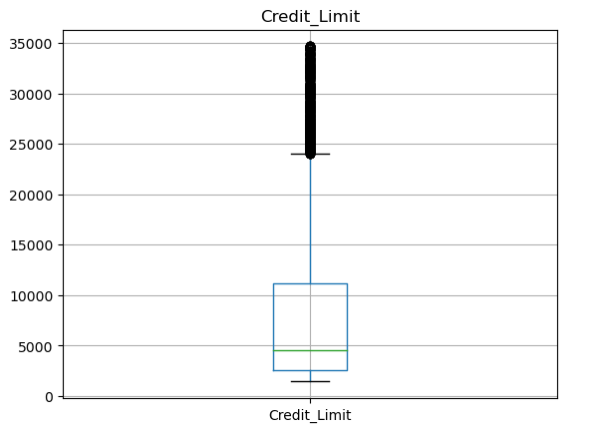
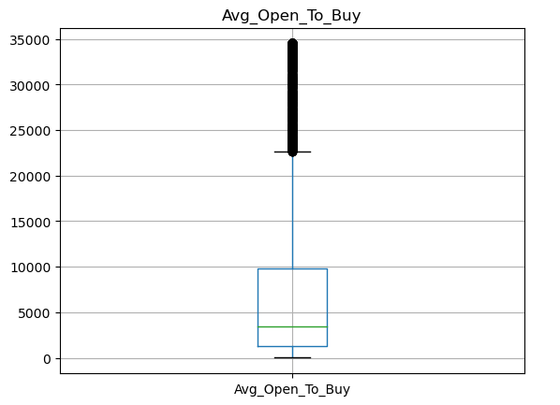
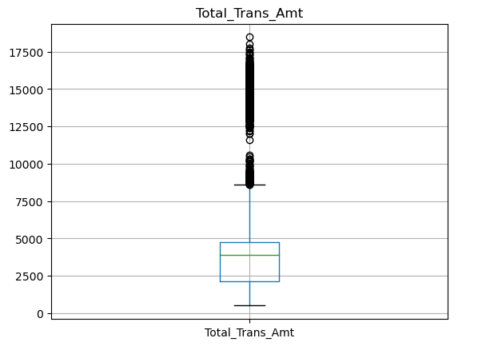
Outlier Graphs

Slide 7
Null Value Treatment
Two Columns:
Card Category - 132 rows
Mode used to impute data: Blue Card
Credit Limit - 60 rows
Caution when imputing
Average used for imputation: $8703
Median more appropriate upon further investigation: $4557
Time constraints did not allow for revision
Relatively few rows
Exportation after investigation and treatment

Slide 8
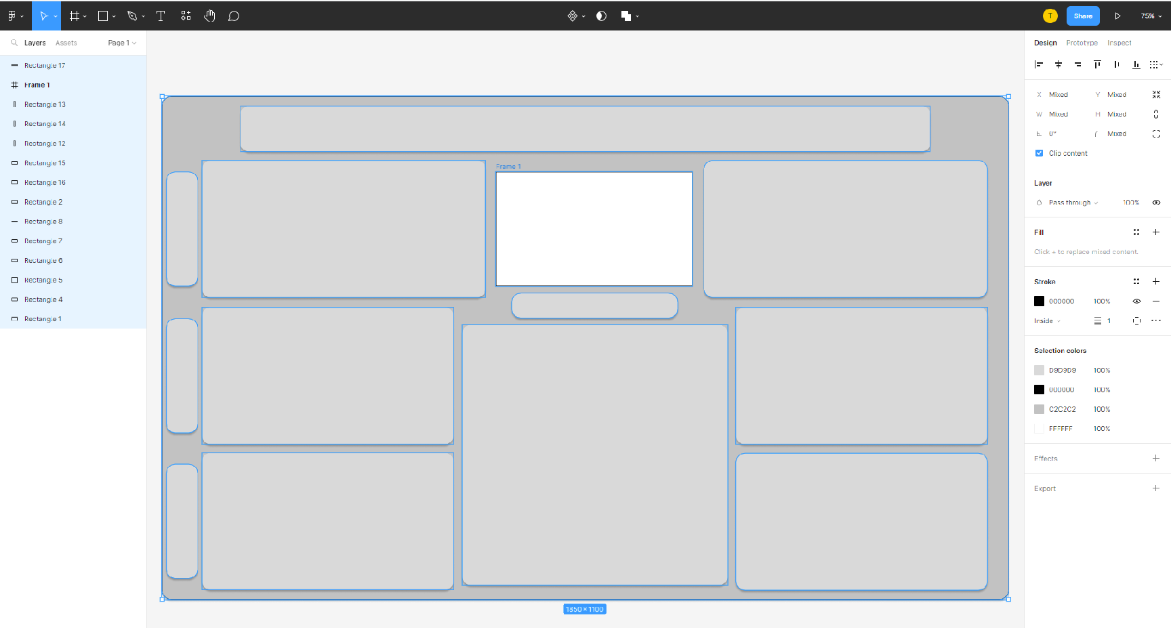
Tableau Analysis & Figma Template

Slide 9
Tableau Dashboards
Existing vs Attrited Customers
Majority existing
Majority in England
Majority in Blue card category
Gender evenly distributed
Dashboard:
https://public.tableau.com/app/profile/tanner7759/viz/CapstoneProjectPart2_16796067762040/Dashboard1#1

Slide 10
Tableau Dashboards (cont.)
Customer Retention and Opportunity Analysis
Most prevalent income category: Below $40k
Most prevalent card category: Blue
Retention: Below $40k and Blue card
Families, people getting by, necessities and emergencies
Opportunity: Top two income categories and Platinum card
Wealthier individuals, occasional impulse or large purchase, immediately reconciled
https://public.tableau.com/app/profile/tanner7759/viz/CapstoneProjectPart2_16796067762040/Dashboard2?publish=yes

Slide 11
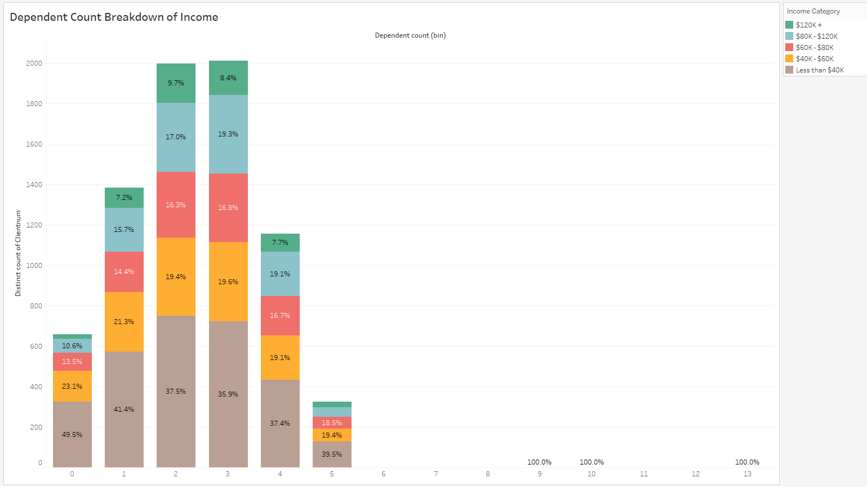
Challenges
Dependent Count Outliers
Average: 2.78
Max: 143
Std dev: 6.48
Graph filter: 16
Valuable Metric
Unreliable

Slide 12
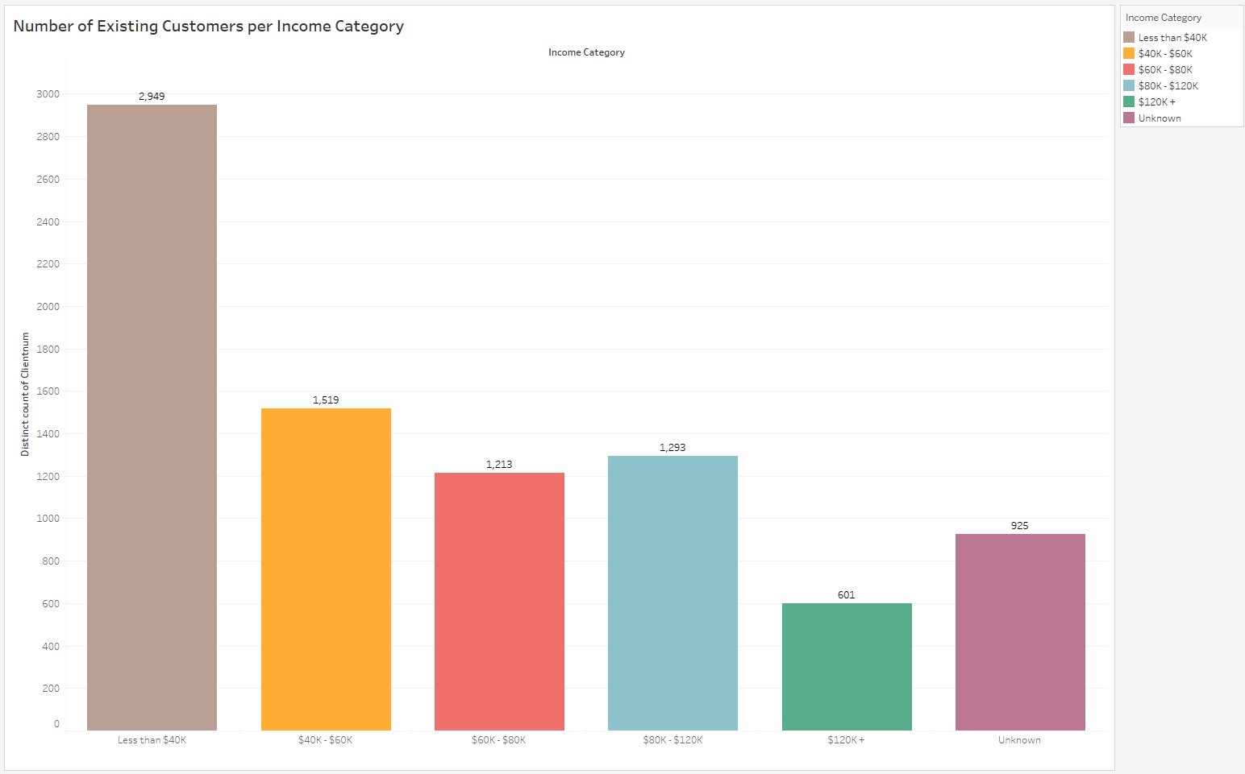
Challenges (cont.)
Income Category: Unknown
Not a majority
Not insignificant

Slide 13

Conclusion
The bank needs to focus on lower income opportunity to maintain retention of customers
Provide incentives for higher income and card category customers
Investigate more into outlying data to improve confidence of analysis
Investigate dependent count for incentives toward family purchases or college spending

